Slide 1
CZ2007 Introduction to Database Systems

Slide 2
Course Instructors
Ng Wee Keong
awkng@ntu.edu.sg
Course instructor before recess week
Arijit Khan
assourav@ntu.edu.sg
Course instructor after recess week

Slide 3
My Teaching Style
There will be small exercises throughout most lectures
Questions will be welcomed
Attendance of lectures is not required (if you can learn by yourself)

Slide 4
Course Structures
CZ2007
Relational Database (11 weeks)
Modeling
Querying
Normalization
Security models
XML (2 weeks)
What it is?
Querying
XML-to-Relational mapping

Slide 5
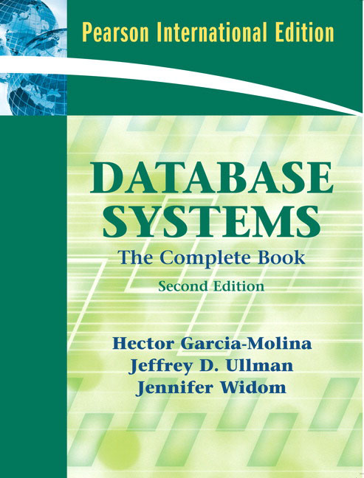
Main Textbook
Database Systems: The Complete Book
Hector Garcia-Molina
Jeffrey D. Ullman
Jennifer Widom

Slide 6

Reference Book 1
Database Management Systems
Raghu Ramakrishnan
Johannes Gehrke

Slide 7
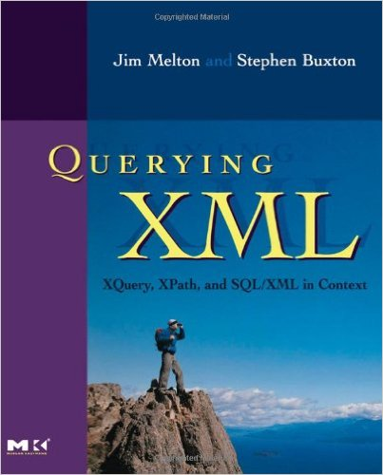
Reference Book 2
Querying XML: XQuery, XPath, and SQL/XML in context
Jim Melton
Stephen Buxton

Slide 8
Tutorials
Start from Week 2
Each tutorial consists of two sets of questions
Classroom exercises
Answers will be released in the tutorials
Critical thinking exercises
Answers will not be released
You need to come up with your own solutions, then contact your tutor for individual discussions

Slide 9
Labs
Start from Week 3
About the design and implementation of a real-world relational database application
Details will be released on NTUlearn
Group-based
Note: Don’t miss Lab 1, 3, and 5
We take attendance in those 3 labs

Slide 10
Quizzes
CZ2007: Two quizzes
Quiz 1 in Week 8 (in tutorials)
Quiz 2 in Week 13
Note: Don’t miss the quizzes
There is no make-up quiz

Slide 11
Grade Weights
Exam: 50%
Lab project: 30%
Quizzes: 20%

Slide 12
Learning Outcome
Discuss the importance of, and uses for, databases within organizations
Be able to design a basic relational database management system (DBMS) for storing and analyzing datasets of medium complexity
Formulate basic relational database queries and execute these in order to analyze business opportunities and risks
Ensure data integrity through enacting the process of database normalization
Understand the usage of indexing to improve query efficiency
Understand the significance of XML and JSON in today's world
Acquire the language necessary for speaking knowledgeably about data management

Slide 13
Learning Outcome
Discuss the importance of, and uses for, databases within organizations
Be able to design a basic relational database management system (DBMS) for storing and analyzing datasets of medium complexity
Formulate basic relational database queries and execute these in order to analyze business opportunities and risks
Ensure data integrity through enacting the process of database normalization
Understand the usage of indexing to improve query efficiency
Understand the significance of XML and JSON in today's world
Acquire the language necessary for speaking knowledgeably about data management
In short: This course is about the fundamentals of database design and applications

Slide 14
Roadmap
Database Systems: Basics
Entity-Relationship (ER) Diagrams

Slide 15
Database and DBMS
What is a database?
A collection of data specially organized for efficient retrieval by a computer
What is a database system?
A piece of software that helps us efficiently manage/retrieve information from databases
More formal name: Database Management System (DBMS)

Slide 16
DBMS in Practice
Large web sites rely heavily on DBMS
Facebook
Twitter
Many non-web companies, too
E.g., Banks
Even small pieces of software on your computer
E.g., Google Chrome

Slide 17
Relational Model
Numerous DBMS exist on the market
Oracle, SQL Server, DB2, MySQL…
Most of them follow the relational model
What does it mean?
Answer: They store all data in relations

Slide 18
Relation
Product
Name | Price | Category | Manufacturer
iPhone 6 | 888 | Phone | Apple
iPad Air 2 | 668 | Tablet | Apple
Galaxy | 798 | Phone | Samsung
EOS-1D X | 1199 | Camera | Canon
Some jargons:
A relation is often referred to as a table
A row in a table is also called a tuple or a record
A column in a table is also called an attribute of the table

Slide 19
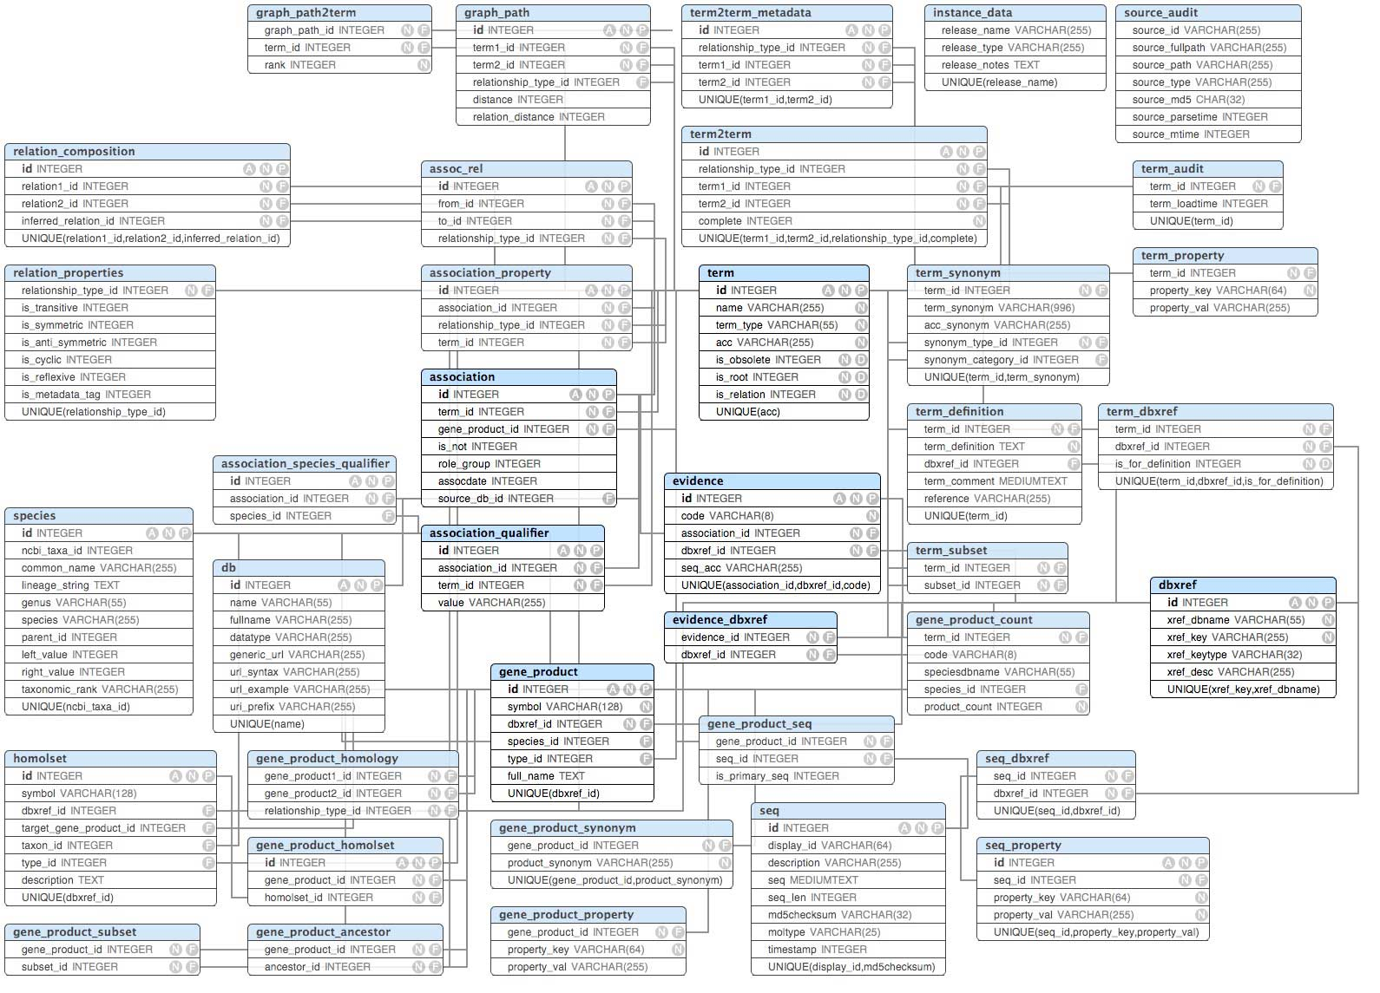
A real database may have a large number of tables…

Slide 20
A real database may have a large number of tables…
Imagine that you are ask to design a database like this….
How would you approach the problem?

Slide 21
Designing a Database for an Application
Conceptually model the requirements of the application
What are the things that need to be stored?
How do they interact with each other?
Tool to use: Entity-Relationship (ER) Diagrams
A pictorial and intuitive way for modelling
Translate the conceptual model into a set of tables
Construct the tables with a DBMS

Slide 22
ER Diagram
name
addr
name
price
Employ
Persons
Buy
Products
country
Make
Companies
category
name

Slide 23
ER Diagram
Persons
Products
Companies
Rectangle = Entity Set
Entity = Real-world object (e.g., a bar)
Entity Set = Collection of similar objects (e.g., a set of bars)
Analogue: An object class

Slide 24
ER Diagram
name
addr
name
price
Persons
Products
country
Companies
category
name
Oval = Attribute = Property of an entity set

Slide 25
ER Diagram
name
addr
name
price
Employ
Persons
Buy
Products
country
Make
Companies
category
name
Diamond = Relationship = Connection between two entity sets

Slide 26
ER Diagram
name
addr
name
price
Persons
Buy
Products
category
Diamond = Relationship = Connection between two entity sets
Persons buy products

Slide 27
ER Diagram
name
price
Why is there an arrow?
Products
country
Make
Companies
category
name
Diamond = Relationship = Connection between two entity sets
Companies make products

Slide 28
Types of Relationships
Many-to-Many Relationships
Many-to-One Relationships
One-to-One Relationships

Slide 29
Many-to-Many Relationship
name
addr
name
price
Persons
Buy
Products
category
One person can buy multiple products
One product can be bought by multiple persons

Slide 30
Many-to-One Relationship
name
price
Products
country
Make
Companies
category
name
One company can make multiple products
But one product can only be made by one company

Slide 31
One-to-One Relationship
Cities
Capital of
Countries
A city can be the capital of only one country
A country can have only one capital city

Slide 32
Multi-way Relationships
Persons
Buy
Products
Stores
What if we want to record the store from which the person buys the product?
We can use a 3-way relationship
Drawback: The arrows would be complicated

Slide 33
Multi-way Relationships
Persons
Buy
Products
Stores
What does this mean?
One <person, store> pair can correspond to one product
But one product can correspond to many <person, store> pairs
Meaning: A person only buys one product from one shop

Slide 34
Multi-way Relationships
Persons
Buy
Products
Stores
What does this mean?
From <person, store> to product: many to one
From <person, product> to store: many to one
Note: not required in the quiz/exam

Slide 35
From Multi-way to Binary
Persons
Buy
Products
Stores
Persons
Buyer of
Product of
Transactions
Products
Stores
Store of

Slide 36
Exercise
Players
Prefer
Games
Each player prefers only one game, but not vice versa
Many-to-many?
Many-to-one?
One-to-one?

Slide 37
Exercise
Products
Sell
Shops
No two shops sell the same product
Many-to-many?
Many-to-one?
One-to-one?

Slide 38
Exercise
Players
From
Countries
Any two players are from exactly two different countries
Many-to-many?
Many-to-one?
One-to-one?

Slide 39
Exercise
Consider two entity sets, Shops and Companies
Each shop sells products from at least one company
Each company has its product sold at least one shop
A shop may be the flagship shop of at most one company
Each company has at least one flagship shops
Draw some relationships between Shops and Companies to capture the above statements

Slide 40
There can be multiple relationships between two entity sets

Slide 41
Roles
Husband
Persons
Married
Wife
Sometimes an entity set may appear more than once in a relationship
Example: some persons are married to each other
The role of the person is specified on the edge connecting the entity set to the relationship
Husband | Wife
Bob | Alice
David | Cathy
… | …

Slide 42
One More Thing about Relationships
A relationship can have its own attribute
name
addr
name
price
Persons
Buy
Products
category

Slide 43
One More Thing about Relationships
A relationship can have its own attribute
If we want to record the date of the purchase
name
addr
name
price
Persons
Buy
Products
date
category

Slide 44
Constraints
Some conditions that the entity sets and relationships should satisfy
We will focus on three types of constraints
Key constraints
Referential integrity constraints
Degree constraints

Slide 45
Key
name
addr
Persons
One or more attributes that are underlined
Meaning: Each person must have a unique name

Slide 46
Key
name
price
Products
category
One or more attributes that are underlined
Meaning: Each product has a unique name

Slide 47
Key
name
price
Products
category
One or more attributes that are underlined
What now?
Each product has a unique <name, category> combination
But there can be products with the same name, or the same category, but not both
Example
Name = “Apple”, Category = “Fruit”, Price = “1”
Name = “Apple”, Category = “Phone”, Price = “888”

Slide 48
Key
name
price
Products
category
Rule: Every entity set should have a key
So that we can uniquely identify an entity in the entity set

Slide 49
Referential Integrity
Companies
Make
Products
One company may make multiple products
One product is made by one company
Can there be a product that is not made by any company?
No.
i.e., every product must be involved in the Make relationship
This is called a referential integrity constraint.
How do we specify this in an ER diagram?
Use a rounded arrow instead of a pointed arrow

Slide 50
Referential Integrity
Companies
Make
Products
One company may make multiple products
One product is made by one company
Can there be a product that is not made by any company?
No.
i.e., every product must be involved in the Make relationship
This is called a referential integrity constraint.
How do we specify this in an ER diagram?
Use a rounded arrow instead of a pointed arrow

Slide 51
Referential Integrity
Companies
Make
Products
What if every company should make at least one product?
No arrow there….
In general, a referential integrity constraint can only apply to the “one” side of
A many-to-one relationship, or
A one-to-one relationship
Why? Will be clear later in this course
For the “many” side, there is another type of constraints to use (will be discussed shortly)

Slide 52
Referential Integrity: Exercise
Cities
Capital of
Countries
A city can be the capital of only one country
A country must have a capital

Slide 53
Referential Integrity: Exercise
Persons
Hire
Companies
A company must hire at least one person
A person must be hired by exactly one company

Slide 54
Degree Constraint
≥ 1
Companies
Make
Products
Each company should make at least 1 product

Slide 55
Degree Constraint
≤ 1000
Companies
Make
Products
Each company can make at most 1000 product
Note
Not required in the quiz/exam
Degree constraints are not easy to enforce in a DBMS
Key and referential integrity constraints can be easily enforced

